Slide 1
Forgiveness
Part 2: How Does God Forgive?
Notes:
My 4th-grade teacher had a temper…
Announced ‘on the war path’
Stephen L→ forced to say ‘sorry’
She never forgot, though…
We’ve all experienced forgiveness this way…
Even ourselves: hard to let go…
God knows everything. How does he forgive?
We started last week talking about forgiveness. Forgiveness is defined by God. To understand what forgiveness means for us, we have to understand how God forgives…
So what are we talking about when we talk about God’s forgiveness? How does God forgive?
God’s forgiveness is described for us in pictures…
Two important pictures are the altar and the cross. These pictures teach us…

Slide 2
God’s Forgiveness is by Grace
Notes:
Sin is ingratitude…
The tactic of Satan here is to move Eve’s eyes from everything God has provided to the restrictions…
“Did God really say?”
Look at the boundaries and begin to wonder: Is God holding out on me?
Don’t want what God gives... start looking for something else instead…
Paul talks about his in Romans 1… sort of the ‘Genesis 3’ of the NT…

Slide 3
If you, O Lord, kept a record of sins, O Lord, who could stand? But with you there is forgiveness; therefore you are feared.
—Psalm 130:3-4
The altar demonstrates the gravity of sin

Slide 4
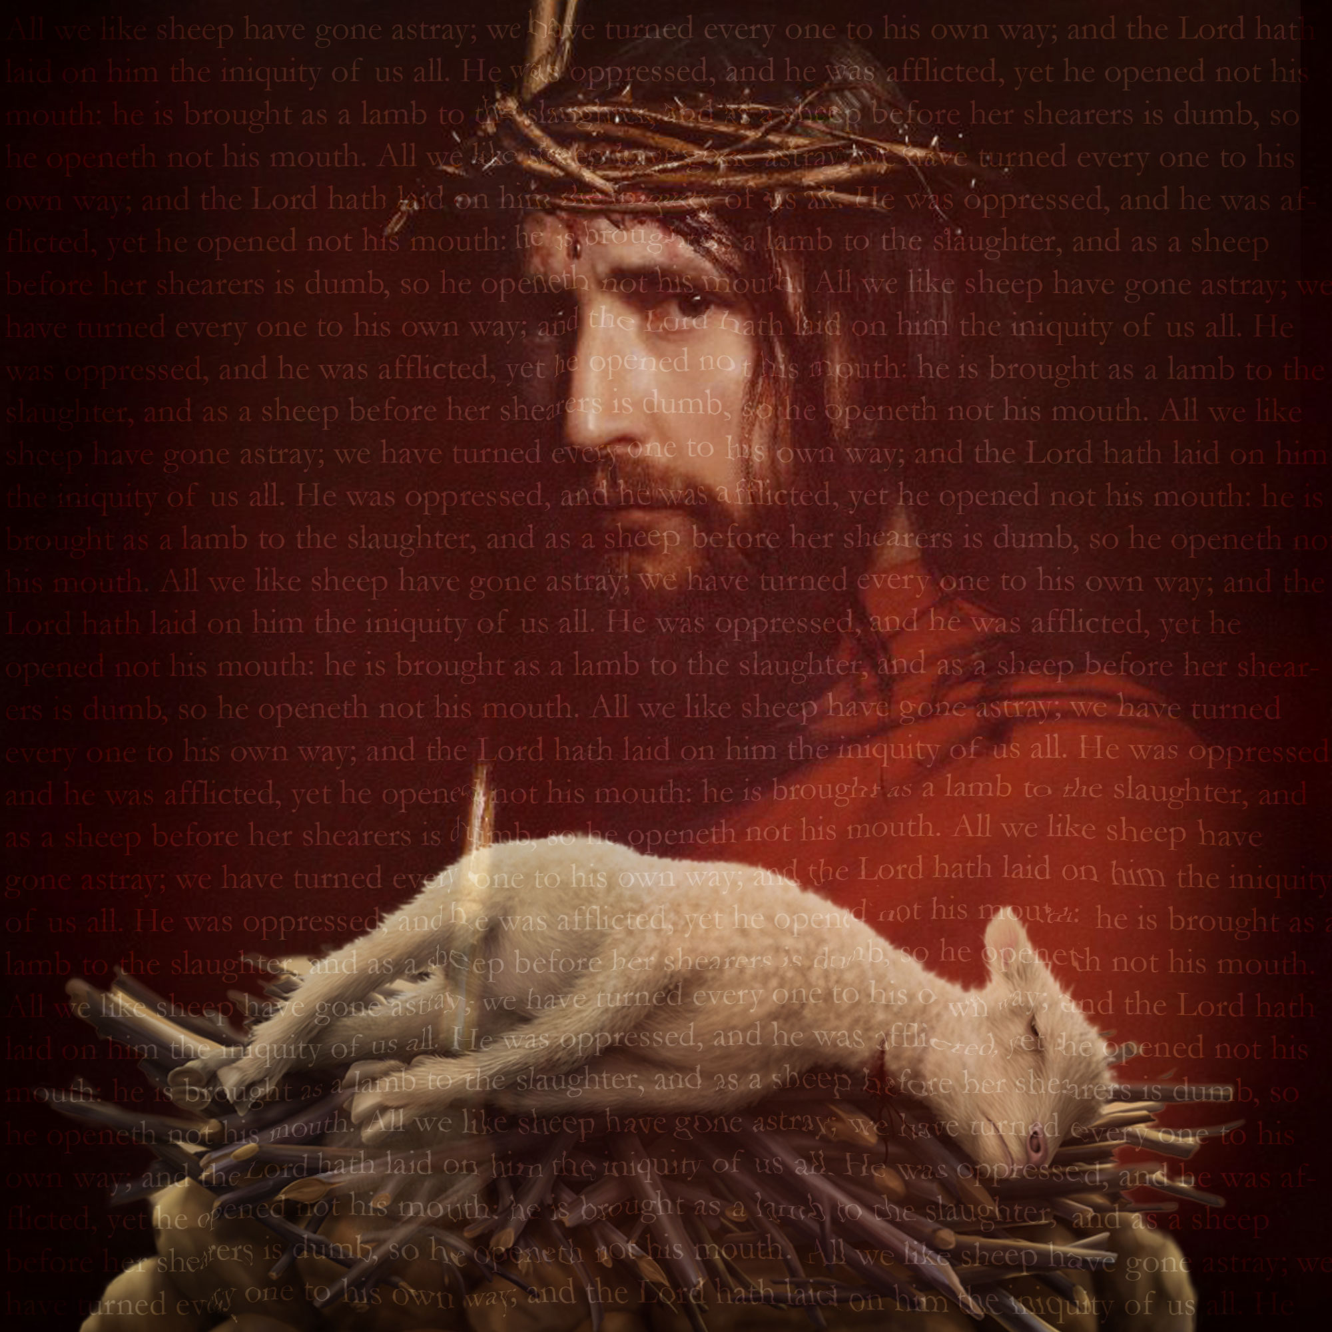
If I were hungry I would not tell you, for the world is mine, and all that is in it.
—Psalm 50:12
God provides the means of forgiveness himself

Slide 5
But those sacrifices are an annual reminder of sins, because it is impossible for the blood of bulls and goats to take away sins.
—Psalm 50:12
God provides the means of forgiveness himself

Slide 6
But now a righteousness from God, apart from law, has been made known, to which the Law and the Prophets testify. This righteousness from God comes through faith in Jesus Christ to all who believe. There is no difference, for all have sinned and fall short of the glory of God, and are justified freely by his grace through the redemption that came by Christ Jesus. God presented him as a sacrifice of atonement, through faith in his blood…
—Romans 3:21-25
At the cross, God provided Jesus for once-for-all forgiveness.

Slide 7
Therefore, there is now no condemnation for those who are in Christ Jesus, because through Christ Jesus the law of the Spirit of life set me free from the law of sin and death. For what the law was powerless to do in that it was weakened by the sinful nature, God did by sending his own Son in the likeness of sinful man to be a sin offering. And so he condemned sin in sinful man, in order that the righteous requirements of the law might be fully met in us, who do not live according to the sinful nature but according to the Spirit.
—Romans 8:1-4

Slide 8
God’s Forgiveness is Thorough
Notes:
Sin is ingratitude…
The tactic of Satan here is to move Eve’s eyes from everything God has provided to the restrictions…
“Did God really say?”
Look at the boundaries and begin to wonder: Is God holding out on me?
Don’t want what God gives... start looking for something else instead…
Paul talks about his in Romans 1… sort of the ‘Genesis 3’ of the NT…

Slide 9
If we confess our sins, he is faithful and just and will forgive us our sins and purify us from all unrighteousness.
—1 John 1:9
Thoroughly cleansed

Slide 10
“Come now, let us reason together,” says the Lord. “Though your sins are like scarlet, they shall be as white as snow; though they are red as crimson, they shall be like wool.”
—Isaiah 1:18
Thoroughly cleansed

Slide 11
The Lord is compassionate and gracious, slow to anger, abounding in love. He will not always accuse, nor will he harbor his anger forever; he does not treat us as our sins deserve or repay us according to our iniquities. For as high as the heavens are above the earth, so great is his love for those who fear him; as far as the east is from the west, so far has he removed our transgressions from us.
—Psalm 103:8-12
Thoroughly separated

Slide 12
You will again have compassion on us; you will tread our sins underfoot and hurl all our iniquities into the depths of the sea.
—Micah 7:19
Thoroughly separated

Slide 13
“I, even I, am he who blots out your transgressions, for my own sake, and remembers your sins no more.”
—Isaiah 43:25
Debt completely cancelled

Slide 14
“When you were dead in your sins and in the uncircumcision of your sinful nature, God made you alive with Christ. He forgave us all our sins, having canceled the written code, with its regulations, that was against us and that stood opposed to us; he took it away, nailing it to the cross.”
—Colossians 2:13-14
Debt completely cancelled

Slide 15
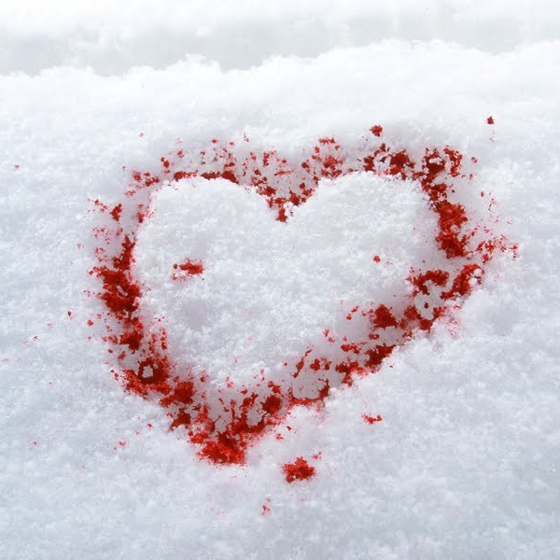
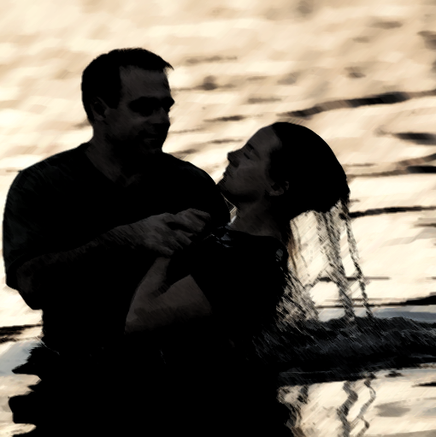
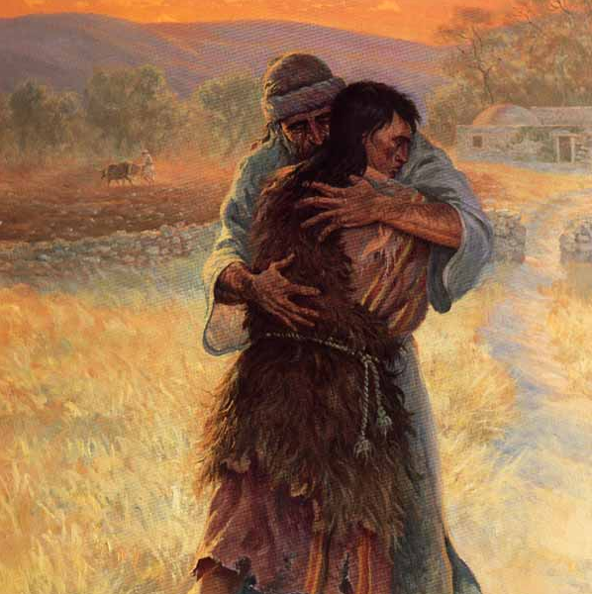
God’s Forgiveness is Relational

Slide 16
“Come now, let us reason together,” says the Lord. “Though your sins are like scarlet, they shall be as white as snow; though they are red as crimson, they shall be like wool.”
—Isaiah 1:18
Forgiveness is a personal process

Slide 17
“Repent and be baptized, every one of you, in the name of Jesus Christ for the forgiveness of your sins. And you will receive the gift of the Holy Spirit.”
—Acts 2:38
Comes through our response of repentance.

Slide 18
“Repent and be baptized, every one of you, in the name of Jesus Christ for the forgiveness of your sins. And you will receive the gift of the Holy Spirit.”
—Acts 2:38
Relationship fully restored.

Slide 19
Have mercy on me, O God, according to your unfailing love; according to your great compassion blot out my transgressions.
Wash away all my iniquity and cleanse me from my sin.
For I know my transgressions, and my sin is always before me.
Against you, you only, have I sinned and done what is evil in your sight, so that you are proved right when you speak and justified when you judge.

Slide 20
Surely I was sinful at birth, sinful from the time my mother conceived me.
Surely you desire truth in the inner parts; you teach me wisdom in the inmost place.

Slide 21
Cleanse me with hyssop, and I will be clean; wash me, and I will be whiter than snow.
Let me hear joy and gladness; let the bones you have crushed rejoice.
Hide your face from my sins and blot out all my iniquity.

Slide 22
Create in me a pure heart, O God, and renew a steadfast spirit within me.
Do not cast me from your presence or take your Holy Spirit from me.
Restore to me the joy of your salvation and grant me a willing spirit, to sustain me.

