Slide 1
Forgiveness
Part 3: Why Forgive?
Notes:
Imagine you had something stolen from you…
Pencil… (no authorities involved)… yard tool (probably not—hurt relationship)… car (call the police)… child (desperate)…
Might be so desperate to get her back that you would be willing to not even press charges if they would just return her…
But what if you knew where she was, who took her… it was a babysitter… all you had to do was call the police and she could be retrieved… would you call the police or the babysitter first? Give them one last chance?
God created this world good, for his own enjoyment
Created people that he loved… placed this world under their care…
We have stolen this world, seized it for ourselves… seized our lives from him…
In Jesus, God has given us one last chance…
When we surrender it all back to him, he drops the charges, even welcomes us back as family!

Slide 2
Bear with each other and forgive whatever grievances you may have against one another. Forgive as the Lord forgave you.
—Colossians 3:13
Notes:
“Bear with each other and forgive whatever grievances you may have against one another. Forgive as the Lord forgave you.”
Lots of questions… but when someone tells me to do something, the first thing I want to know is why?
As I was preparing for this series, God seemed to point to a passage that was part of my devotional reading and say, “This is your passage” for this question… struggled this week with why…

Slide 3
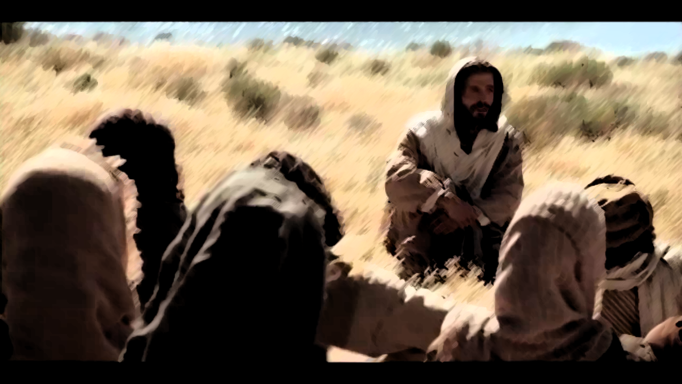
Jesus said to his disciples: “Things that cause people to sin are bound to come, but woe to that person through whom they come. It would be better for him to be thrown into the sea with a millstone tied around his neck than for him to cause one of these little ones to sin. So watch yourselves…”
—Luke 17:1-3
Notes:
Turn to Luke 17:1-10…
arguably only 1-2 verses are specifically about forgiveness…
but I think God showed me something…
vv. 1-3a “…watch yourselves”

Slide 4
It’s our job to protect unity
Notes:
First reason: It’s our job to protect unity…
If you go to our church website—fbcdenison.org—there’s a members’ covenant published there…

Slide 5
“I will protect the unity of my church by acting in love toward others, by refusing to gossip, by supporting the leaders, and by reconciling conflict.”
(from the FBC Denison Membership Covenant)
Notes:
First statement: “I will protect the unity of my church by acting in love toward others, by refusing to gossip, by supporting the leaders, and by reconciling conflict…”

Slide 6
Jesus said to his disciples: “Things that cause people to sin are bound to come, but woe to that person through whom they come. It would be better for him to be thrown into the sea with a millstone tied around his neck than for him to cause one of these little ones to sin.”
—Luke 17:1-2
Notes:
Look at Jesus’ words here: vv. 1-2
Other translations “stumbling blocks”
Greek word: “σκάνδαλον” (“scandal”)… things that cause people to fall away…
Jesus: woe to you if you cause it… woe to you if you keep it cooking…

Slide 7
He who covers over an offense promotes love, but whoever repeats the matter separates close friends.
—Proverbs 17:9
Forgive rather than magnify
Notes:
Proverbs 17:9—“He who covers over an offense promotes love, but whoever repeats the matter separates close friends.”
So we forgive rather than magnify…
What Proverbs is talking about here: someone hurts you… take care of it privately… forgive… don’t spread it…
Not talking about: covering up things like sexual abuse or other huge injustices…
In those cases, the scandal—thing that causes someone who might otherwise trust Christ to fall away—is the injustice…
As people of light, we expose the deeds of darkness, seek justice even as we love mercy
But too often the church gets it backwards… big sins→too embarrassing→cover up
Interpersonal things→repeated→blown up
Conflict tears up the church… injustice left in the darkness tears up lives… We’ll talk more about justice and forgiveness another week…

Slide 8
Make every effort to live in peace with all men and to be holy; without holiness no one will see the Lord. See to it that no one misses the grace of God and that no bitter root grows up to cause trouble and defile many.
—Hebrews 12:14-15
Peace sanctifies, but bitterness defiles.
Notes:
It’s our job to watch out for each other and to guard our own heart: Hebrews 12:14-15…
“Make every effort to live in peace with all men and to be holy; without holiness no one will see the Lord. See to it that no one misses the grace of God and that no bitter root grows up to cause trouble and defile many.”
Peace sanctifies and bitterness defiles…
“bitter” is a word closely associated with resentment and cursing… a heart bent against someone else… result of festering unforgiveness…
Opposite of God’s desire for the church…
Unity, love for one another is what sets us apart, makes us holy… bitterness does the opposite…

Slide 9
“If your brother sins, rebuke him, and if he repents, forgive him. If he sins against you seven times in a day, and seven times comes back to you and says, ‘I repent,’ forgive him.”
—Luke 17:3-4
Notes:
So Jesus tells us to forgive: vv. 3-4…

Slide 10
Forgiveness has great power
Notes:
Forgiveness has great power
Notice first that part of watching out for each other is calling out one another for sin… then forgiving that sin… doesn’t even say “against you” in v. 3!
Story in Mark 2: “Who can forgive sin but God alone?” But look at the power gives us when we are filled with the Holy Spirit…

Slide 11
“If you forgive anyone his sins, they are forgiven; if you do not forgive them, they are not forgiven.”
—John 20:23
Power to bless and to forgive.
Notes:
John 20:23—“If you forgive anyone his sins, they are forgiven; if you do not forgive them, they are not forgiven.”
We’ve been given the power to bless and to forgive
Kingdom works on authority; authority released with a word… (like creation)…
In Jesus’ name, filled w/Spirit, we have the authority to release people from sin…
Something we don’t do enough… someone burdened by sin… “you are forgiven”…

Slide 12
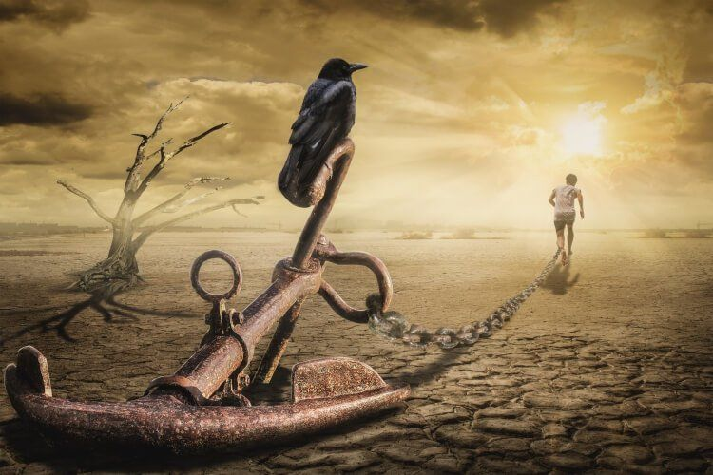
Power to move forward
Notes:
Forgiveness gives power to move forward…
Power to set someone free, just like you were set free…
Scene in an old Robin Hood movie… running past prisoners… sets one free…

Slide 13
Notes:
But, as Christian author Lewis B. Smedes notes: “To forgive is to set a prisoner free and discover that the prisoner was you.”
It’s not easy…

Slide 14
“The apostles said to the Lord, “Increase our faith!”
He replied, “If you have faith as small as a mustard seed, you can say to this mulberry tree, ‘Be uprooted and planted in the sea,’ and it will obey you.”
—Luke 17:5-6
Notes:
disciples say: vv. 5-6…
Tree metaphor is good for this process… “bitter root” can grow down deep…
Takes the power of God and power of faith to uproot it and toss it in the sea… just like God says he does for us (verse from last wk)

Slide 15
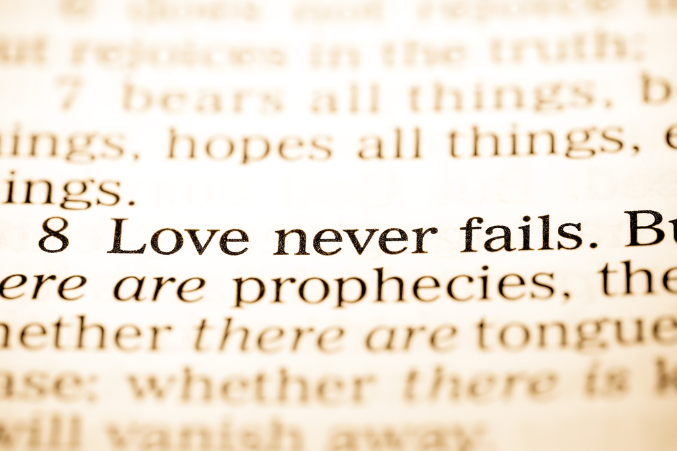
Above all, love each other deeply, because love covers over a multitude of sins.
—1 Peter 4:8
Love never fails.
Notes:
Sin’s greatest enemy is this extravagant, grace-filled love that forgives… one author says when sin had wrecked us and our world, God released his greatest weapon, love.
Love never fails.
1 Peter 4:8:
“Above all, love each other deeply, b/c love covers over a multitude of sins.”

Slide 16
“For if you forgive men when they sin against you, your heavenly Father will also forgive you.”
—Matthew 6:14
Notes:
Receiving this love impels us to extend it to others:
Mt. 6:14—“For if you forgive men when they sin against you, your heavenly Father will also forgive you.”

Slide 17
Forgiveness is a basic duty
Notes:
Forgiveness is a basic duty…
Disciples thought this teaching was one that required extraordinary faith…

Slide 18
“Suppose one of you had a servant plowing or looking after the sheep. Would he say to the servant when he comes in from the field, ‘Come along now and sit down to eat’? Would he not rather say, ‘Prepare my supper, get yourself ready and wait on me while I eat and drink; after that you may eat and drink’? Would he thank the servant because he did what he was told to do? So you also, when you have done everything you were told to do, should say, ‘We are unworthy servants; we have only done our duty.’ ”
—Luke 17:1-10
Notes:
Jesus compares it to a servant doing only what’s required: vv. 7-10…
Jesus says staying faithful to him and to one another, warning each other and freely forgiving one another isn’t some great feat… it’s your duty.

Slide 19
For if you forgive men when they sin against you, your heavenly Father will also forgive you.
—Matthew 6:14
Forgiving others is a natural response to receiving God’s forgiveness.
Notes:
This is because forgiving others is a natural response receiving God’s forgiveness…
If you truly understand God’s forgiveness, it would be unthinkable not to forgive others...
You’ve been hurt→this helps you understand the cost of sin… God forgave you, you must also forgive…
God requires this of us…

Slide 20
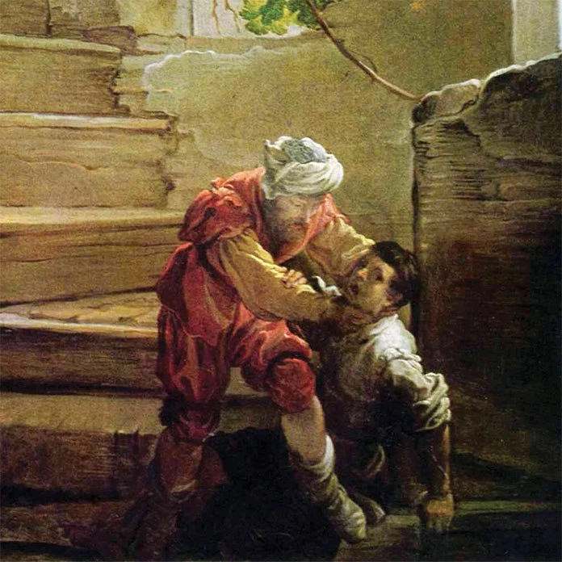
“In anger his master turned him over to the jailers to be tortured, until he should pay back all he owed.
“This is how my heavenly Father will treat each of you unless you forgive your brother from your heart.”
—Matthew 18:34-35
Unforgiveness opens the door to torment
Notes:
in fact, unforgiveness opens the door to torment in our lives…
Mt. 18:34-35—“In anger his master turned him over to the jailers to be tortured, until he should pay back all he owed. This is how my heavenly Father will treat each of you unless you forgive your brother from your heart.”
God warns us that we face his wrath if we don’t forgive as we’ve been forgiven…
We’ll talk about this more in coming weeks...
Jesus says the law is fulfilled when we treat others as we want to be treated… by God…

Slide 21
God loves you like you never hurt him.
Notes:
God loves us like we never hurt him… Jentezen Franklin adapting an old Satchel Paige quote…
Invitation
So this is how we respond to God’s forgiveness:

Slide 22
Get rid of all bitterness, rage and anger, brawling and slander, along with every form of malice. Be kind and compassionate to one another, forgiving each other, just as in Christ God forgave you.
—Ephesians 4:31-32
Notes:
Eph. 4:31-32—“Get rid of all bitterness, rage and anger, brawling and slander, along with every form of malice. Be kind and compassionate to one another, forgiving each other, just as in Christ God forgave you.”
Time to release this morning… start with family…
Move to church family… release… bitterness, rage, and anger… slander and malice…
Tell God: “I’m willing to forgive… show me…”
Altar open… come for decision… prayer.

